Slide 1
Introduction to Inheritance

Slide 2
What Is Inheritance?
Inheritance is a mechanism in which one class acquires the property of another class.
For example, a child inherits the traits of his/her parents.
With inheritance, we can reuse the fields and methods of the existing class.
Hence, inheritance facilitates Reusability and is an important concept of OOPs.

Slide 3
Inheritance terminology
A descendant of a class C is any class that inherits directly or indirectly from C, including C itself.
A proper descendant of C is a descendant other than C itself.
An ancestor of C is a class A such that C is a descendant of A. A proper ancestor of C is a class A such that C is a proper descendant of A.

Slide 4
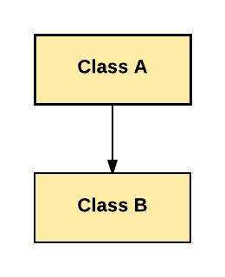
Types of Inheritance
Single Inheritance: In Single Inheritance one class extends another class (one class only).
In above diagram, Class B extends only Class A. Class A is a super class and Class B is a Sub-class.

Slide 5
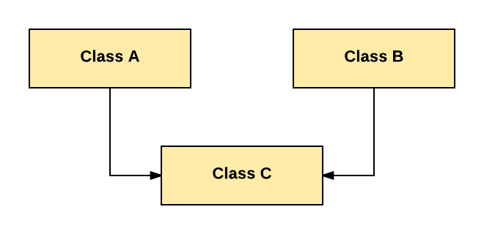
Types of Inheritance
Multiple Inheritance: In Multiple Inheritance, one class extending more than one class. Java does not support multiple inheritance.
As per above diagram, Class C extends Class A and Class B both.

Slide 6
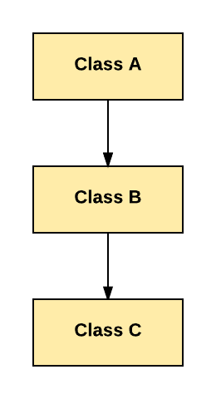
Types of Inheritance
Multilevel Inheritance: In Multilevel Inheritance, one class can inherit from a derived class. Hence, the derived class becomes the base class for the new class.
As per shown in diagram Class C is subclass of B
and B is a of subclass Class A.

Slide 7
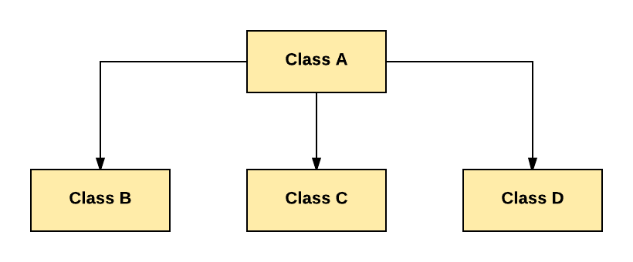
Types of Inheritance
Hierarchical Inheritance: In Hierarchical Inheritance, one class is inherited by many sub classes.
As per above example, Class B, C, and D inherit the same class A.

Slide 8
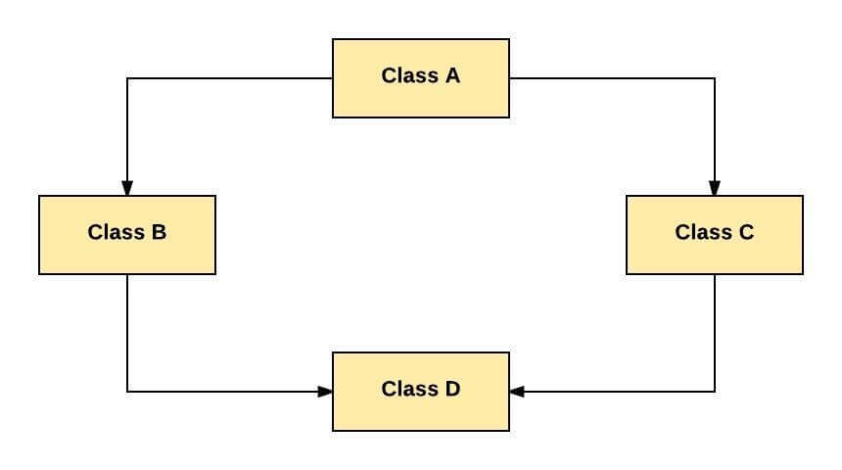
Types of Inheritance
Hybrid Inheritance: Hybrid inheritance is a combination of Single and Multiple inheritance.
As per above example, all the public and protected members of Class A are inherited into Class D, first via Class B and secondly via Class C.

Slide 9
Inheritance in Java
In Java, when an "Is-A" relationship exists between two classes we use Inheritance
The parent class is termed super class and the inherited class is the sub class
The keyword "extends" is used by the sub class to inherit the features of super class
Inheritance is important since it leads to reusability of code

Slide 10

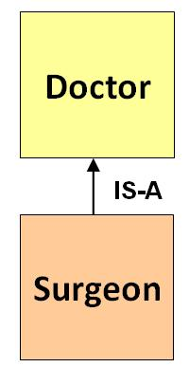
Java Inheritance Syntax & Example:

Slide 11
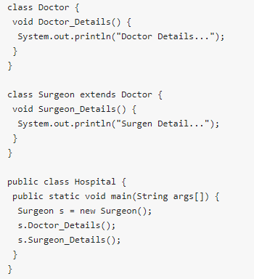
Java Inheritance:

Slide 12

Java Inheritance: Super Keyword
The super keyword is similar to "this" keyword.
The keyword super can be used to access any data member or methods of the parent class.
Super keyword can be used at variable, method and constructor level.
Syntax:

Slide 13
What is Polymorphism?
Polymorphism is a OOPs concept where one name can have many forms.
For example, you have a smartphone for communication.
The communication mode you choose could be anything. It can be a call, a text message, a picture message, mail, etc. So, the goal is common that is communication, but their approach is different. This is called Polymorphism.

Slide 14
Polymorphism
“Polymorphism” means the ability to take several forms. In object-oriented development what may take several forms is a variable entity or data structure element, which will have the ability, at run time, to become attached to objects of different types, all controlled by the static declaration.

Slide 15
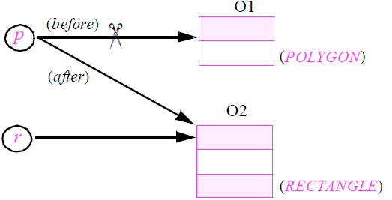
What exactly happens during a polymorphic attachment?
All the entities of polymorphic attachment are of reference types: the possible values for p, r and t are not objects but references to objects.
So the effect of an assignment such as p := r is simply to reattach a reference:

Slide 16
What exactly happens during a polymorphic attachment?
Once created, an object never changes its type. Only references do so by getting reattached to objects of different types. This also means that polymorphism does not carry any efficiency penalty; a reference reattachment — a very fast operation — costs the same regardless of the objects involved.

Slide 17
Method Overriding
Method Overriding is redefining a super class method in a sub class.
Rules for Method Overriding
The method signature i.e. method name, parameter list and return type have to match exactly.
The overridden method can widen the accessibility but not narrow it, i.e. if it is private in the base class, the child class can make it public but not vice versa.

Slide 18
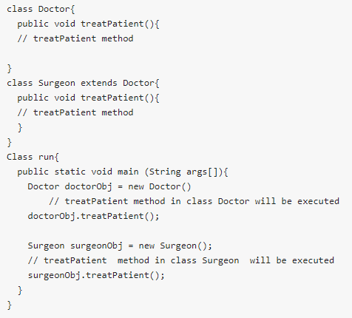
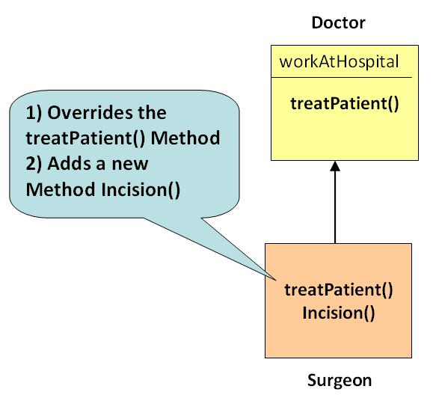
Method Overriding

Slide 19
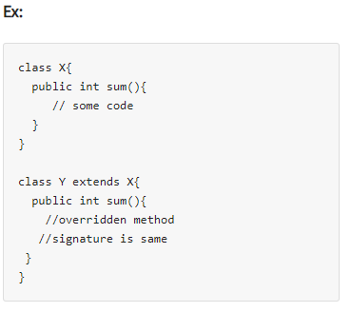
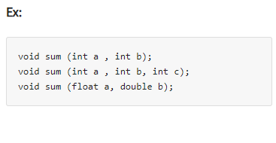
Difference between Overloading and Overriding
Method Overloading | Method Overriding
Method overloading is in the same class, where more than one method have the same name but different signatures. | Method overriding is when one of the methods in the super class is redefined in the sub-class. In this case, the signature of the method remains the same.

Slide 20
Difference between Overloading and Overriding
Method Overloading | Method Overriding
Method overloading is in the same class, where more than one method have the same name but different signatures. | Method overriding is when one of the methods in the super class is redefined in the sub-class. In this case, the signature of the method remains the same.

